Slide 1
QEP: The Q-Value Policy Evaluation Algorithm​
Brandon Rozek​
Advisor: Dr. Ron Zacharski​
Notes:
Hello my name is Brandon Rozek, and today I’m going to talk about a general algorithm that helps a computer learn a task.

Slide 2
Notes:
Some tasks are extremely difficult to program The video here shows the computer trying to balance a pole. To not be fragile, we need to have the computer experience different pole configurations and have it learn what it needs to do to achieve its goal. One of the challenges here is minimizing how many trials the computer needs before it learns how to do its task. As you can see in the video it took 180 tries to have even the most rudimentary balancing of the pole.

Slide 3
Outline
What is Reinforcement Learning?​
Survey of existing algorithms​
Value-based methods​
Policy-based methods​
The QEP Algorithm​
New Loss Function​
Evolutionary Strategies​
Results and Conclusion​
Notes:
In this presentation, we will go over Reinforcement Learning, a research frontier focused on getting computers to learn.
After introducing it, I will go over a couple of the existing methodologies that are used today.
Then I will present the QEP algorithm, talk about the challenges it solves, and finally give results and the conclusion.

Slide 4
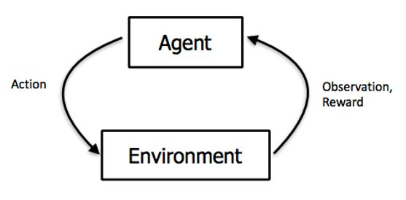
What is Reinforcement Learning?​
With no prior knowledge, being able to select actions in order to maximize the reward that the environment gives out.​
Important Distinction: In this talk, we will focus on tasks that have discrete actions. Such as buy/sell, up/down/left/right.​
Notes:
So what is Reinforcement Learning? It is a way so that even without prior knowledge, the computer can perform actions in order to maximize some sort of reward in the environment.
It is based off of Reinforcement Learning in Psychology. A branch of psychologists believe that our behaviors are influenced by positive and negative reinforcement. For example, I dress professionally for a work event because I might get some form of punishment or negative reward if not.
Our goal is to find a way to encode this into an algorithm for the computer to follow. An important distinction that I’ll make in this talk is that we are focusing on tasks that have discrete actions as opposed to continuous ones. For example, buying/selling a stock, the buttons on a controller, etc. This contrasts to driving where you change the angle of the wheel infinitely many ways.

Slide 5
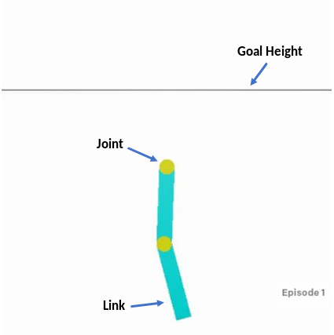
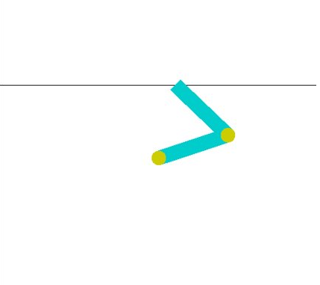
Example Task: Acrobot​
The goal is to swing the end of the lower link up to a given height.​
Notes:
The main task that we’ll follow along with is called Acrobot. Not all robotics research is conducted in reality like the one shown in the video, but algorithm research also occurs within simulations.
In this task, we have two joints and two links, and the goal is to swing the lower link up to a given goal height.

Slide 6
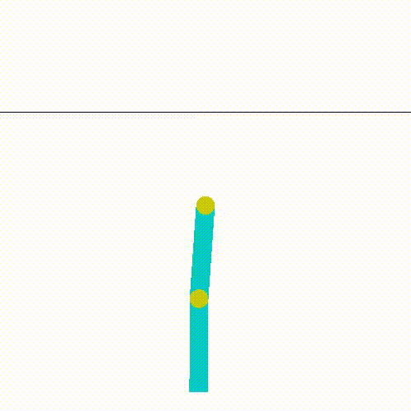
Example Task: Acrobot​
Possible Actions:
Left, Right, Nothing
Reward Structure:
-1 until goal reached
Random Agent
Notes:
The possible actions for this little guy is to wiggle left, wiggle right, or do nothing. The environment is set up so that the computer will receive -1 reward for each turn until the goal is reached.
In Reinforcement Learning, you need to set up the reward structure so that maximizing it accurately reflects the goal of the task. In order to maximize this reward structure, we need to have the lower link reach the given height as soon as possible
The animation here shows the computer randomly performing tasks in hopes to achieving its goal. As you can see, we’ll have to do better.

Slide 7
Survey of Existing Algorithms
Value and Policy Algorithms​
Notes:
So what existing methodologies are there? In the world of model free reinforcement learning, there are value-based and policy-based algorithms.

Slide 8
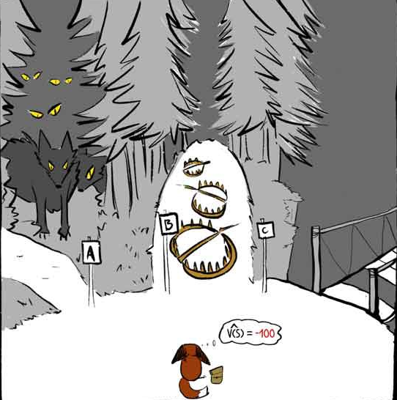
Value-based Algorithms​
Predict outcomes of certain actions.
Action is chosen that leads to best outcome.
Update value predictions by using the history of choices and their outcomes.
Graphic by Rudy Gilman
Notes:
Value based methods are all about getting the computer to accurately predict the outcome of each action in a given scenario. As we try again and again, the idea is that we will become less and less surprised at the outcomes. We can then be confident that choosing the action that leads to a better outcome is the right choice. In this way, we say that it is deterministic, since for a given scenario it will always choose the same action.
We can then get better and better at predicting outcomes just by looking at our past experiences. This allows value-based methods to be what we call, sample efficient, since we can train the algorithm without having to perform another trial in our simulation or reality.
Putting ourselves in the little foxes shoes, I think taking the bridge might lead us to a better outcome. Don’t you think?

Slide 9
Policy-based Algorithms​
Produces a probability for each action.
Example:
Nudge the probabilities towards 1 or 0 depending on what the effect of taking that action was on our rewards.
One of the issues is that probabilities change every time we update our policy, forcing us to throw away past data!​
Notes:
In contrast, policy-based algorithms produces a probability for each action that the computer can take. For example, pretend we are looking at the acrobot task and for this scenario the policy outputs the following probabilities shown on the screen. We can interpret this wiggling left 10% of the time, wiggling right 80% of the time, and doing nothing for the remaining 10%.
As we perform actions in the environment, we adjust the probabilities by seeing what the effect of taking that action was on our rewards. For example, If wiggling left led to a positive reward, then we will increase the probability of taking that action. One of the main issues with this approach is that the probabilities change every time we update our policy, forcing us to throw away past data. This means that every time we want to improve the policy we need to perform more trials either in our simulations or in reality.
As you can see, this might be a problem for some domains like self driving cars, because you cannot just have a car crash into a wall 100 times in order for it to learn not to perform the sequence of actions leading to a crash.

Slide 10
Pros/Cons
Value-based Methods​
Sample Efficient​
No convergence guarantees​
Deterministic​
Policy-based Methods​
Sample Inefficient​
Convergence guarantees​
Stochastic​
Notes:
To summarize the pros and cons. Value-based methods are sample efficient, have no convergence guarantees (meaning that it may not always reach the most optimal solution), and are deterministic.
In contrast, policy based methods are sample inefficient, have convergence guarantees, and are stochastic.
The whole portion about convergence guarantees is outside the scope of this presentation, but will go over the deterministic/stochastic areas shortly.

Slide 11
My Work
Combining ideas from Value and Policy-based methods
Notes:
So now we will be going into what I did to combine these two methodologies to build a better algorithm.

Slide 12
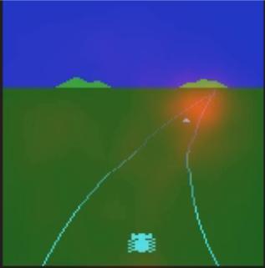
Can we do better?​
Deep Deterministic Policy Gradients algorithm (DDPG) combined benefits of both methods using continuous action spaces.
Steer wheel by 30°
Policy
Action
State
Value Predictor
Value
What we see
Receive higher outcomes if you steer the wheel towards the orange.
Notes:
So the main question to ask is, can we do better?
A paper came out describing Deep Deterministic Policy Gradients. In this algorithm, instead of the policy outputting probabilities, it will produce the action value. If we think about the car driving example again, this would be the degree to which you turn the wheel. For example 30 degrees, 40.1, etc, etc.
The policy is then trained by producing action values that lead to the best outcome using our value function from before
In the graphic shown, higher predicted outcomes are shown by the orange. Steering the wheel 10 degrees to the right will probably lead to higher outcomes. If you steer 10 degrees to the left, you’ll crash and end up receiving no rewards.
.

Slide 13
Issues
With Updating
Discrete action spaces are not continuous so that makes the way we update under this method not differentiable.
Our standard update algorithms depend on that property.
With Determinism
We live in a world of imperfect information.
Others can find a way to exploit determinism.
Notes:
The unfortunate part, is that the algorithm utilizes the continuous property of the action to perform its updates. This means that with its current configuration, it will not work for tasks with discrete actions like acrobot.
There’s also a not so obvious issue with determinism. We live in a world of imperfect information, how do we know that a certain action does indeed lead to the best outcome? Another issue is that others can find a way to exploit a deterministic algorithm.
Imagine a game of Rock, Paper, & Scissors. If you trained the algorithm and it decides to always throw rock, then it’s easy for an opponent to counter you, just throw paper. In this case you can see the use of a stochastic policy that will just assign a ⅓ probability for rock, paper, and scissors.
Now this might be a silly example, but you can see where these algorithms may go wrong. Hackers could be able to create scenarios which cause the computer performs actions they wanted. With computers performing more and more important tasks in our lives it’s important to be aware of this. In the field of adversarial reinforcement learning, there is what is called an enchanting attack which gets the computer to perform a completely different task than desired. Pretty creepy if you ask me. So in the algorithm I propose, we will actually keep stochasticity as a way to help mitigate that issue.

Slide 14
CMAS-ES Algorithm​
Take your function parameters and add Gaussian noise to generate different models​.
Test these different models to see how much reward they obtain.​
Move the new solution to areas weighted by reward​.
Notes:
To replace our update mechanism, we will use what is called an evolutionary algorithm. This is a class of algorithms inspired by evolutionary biology.
First we need an initial guess of how to assign the probabilities of each action. That will be the black box. Then we will change the probabilities ever so slightly and generate a bunch of different models, as represented by the black dots.
We then measure how well each of the black dots perform with respect to our predicted outcomes from before. The better the outcome, the darker the blue in our animation. We will then move our current guess, which is the large black box, to the area weighted by the most dark blue.

Slide 15
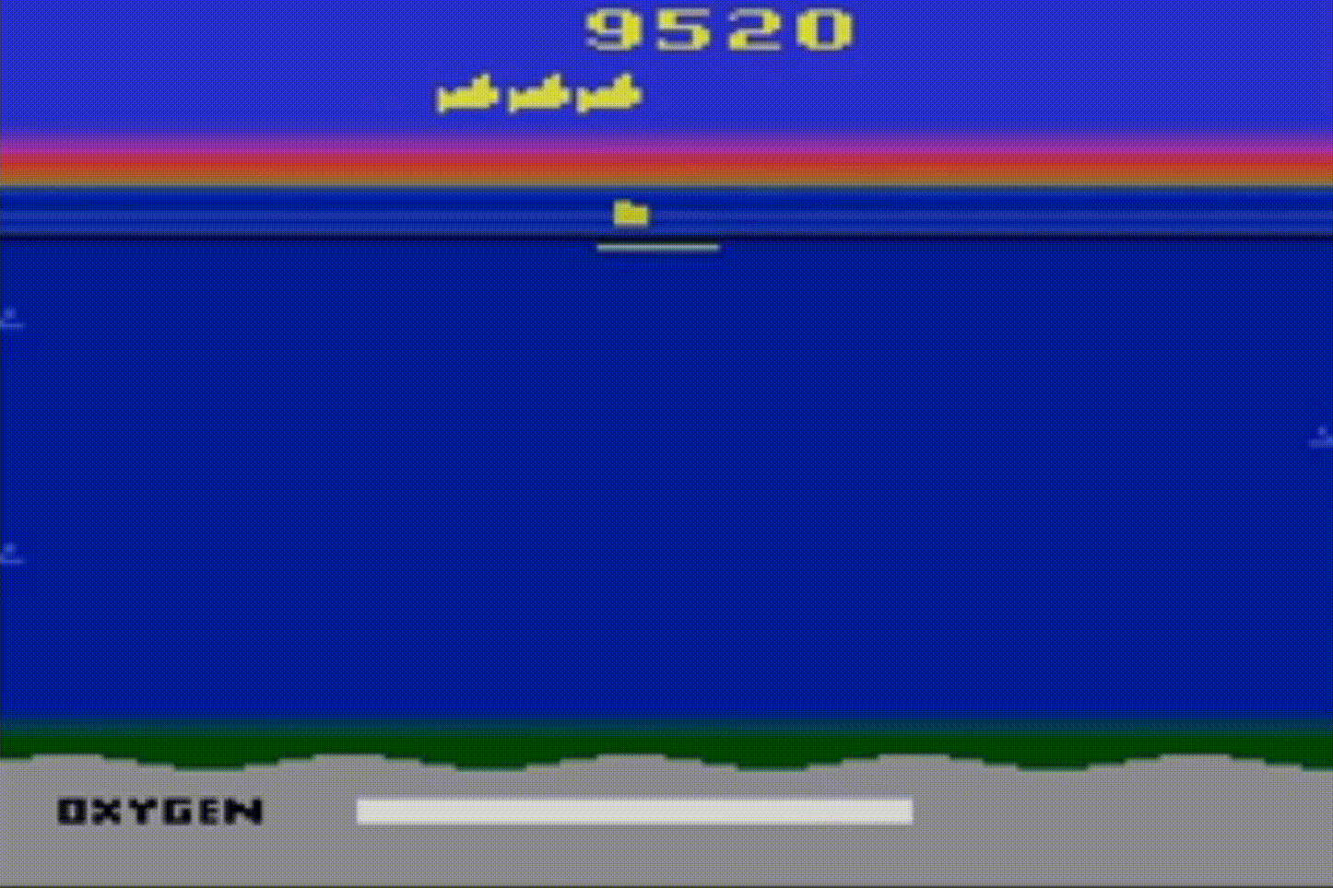
Encouraging Exploration
Sometimes the computer can get stuck if it it hasn’t tried enough possibilities.
In SeaQuest, you gain rewards by rescuing divers, but lack of oxygen cause early death.
QEP penalizes the computer more, the farther it assigns probabilities from uniformity.
Notes:
Another improvement that we’ll make to the algorithm is to encode a way for the computer to be encouraged to try out new sequences of actions. This is to mitigate issues where the computer believes that its current procedure leads to the best result even though there are better ones out there.
For example in SeaQuest, an Atari game, you gain rewards by rescuing divers and shooting fish. If you don’t periodically go up for air then you will lose a life in the game. But going up doesn’t lead to immediate positive rewards. So by encouraging exploration, you give a bonus to the algorithm for trying out tasks that don’t lead to immediate rewards.
QEP does this by penalizing the computer the farther it assigns probabilities away from uniformity.

Slide 16
Results​
QEP reaches the optimal solution faster than the state of the art value-based method on tasks such as Acrobot and CartPole!​
Trial 13
Trial 44
QEP
Rainbow DQN
Notes:
With that in place, and several other architectural changes, we actually come out with an algorithm that reaches the optimal solution faster than the best value-based method out there. This means that QEP is more sample efficient than the other.
As you can see, QEP reaches the optimal solution around trial 13 while the rainbow-dqn method requires up to 44 trials to reach the optimal solution.

Slide 17
QEP Pros/Cons
Sample Efficient​
No convergence guarantees​
Stochastic
Way to encourage exploration
Notes:
To quickly summarize QEPs pros and cons, it is sample efficient, have no convergence guarantees, is stochastic, and includes a method to encourage exploration.

Slide 18
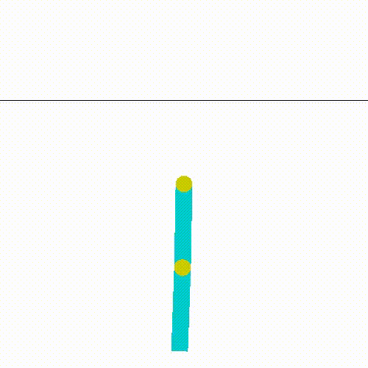
Conclusion​
QEP combines the benefits of sample efficiency and stochasticity to do well on tasks such as Acrobot.​
Future work includes identifying areas in which QEP fails as well and making improvements to the algorithm​.
Check out my code library on GitHub!​
https://github.com/Brandon-Rozek/rltorch ​
Notes:
In conclusion, we have created an algorithm that is more sample efficient than the value-based methods out there and also keeps the stochastic nature which we wanted.
Future work will include identifying conditions that cause QEP to fail. Since it does not always reach the optimal solution the fastest on all tasks.
An implementation of this algorithm, and many others, can be found online at this URL.
The little anitmation here is QEP performing the Acrobot task!

Slide 19
Thanks!
Any questions?
Notes:
Thanks, everyone. Any questions?

Slide 20
Research References​
OpenAI Gym, Brockman et al, 2016. Code Framework​.
RLPy: A Value-Function-Based Reinforcement Learning Framework for Education and Research, Geramifard et al, 2015. Acrobot Task​.
Policy gradient methods for reinforcement learning with function approximation. Sutton et al, 2000. Algorithm: PPO​.
Playing Atari with Deep Reinforcement Learning, Mnih et al, 2013. Algorithm: DQN.​
Continuous Control With Deep Reinforcement Learning, Lillicrap et al, 2015. Algorithm: DDPG.​
Evolution Strategies as a Scalable Alternative to Reinforcement Learning, Salimans et al, 2017. Algorithm: ES.​

Slide 21
Presentation References​
Video Snippets from:
Learning to Swing-Up and Balance from Scratch. Dr. Martin Riedmiller
Today I Tried: Evolutionary Strategies. Giant_Neural_Network
Seaquest for the Atari 2600. 2600online
Presentation template by SlidesCarnival

Slide 22
Backup Slides
For the curious...

Slide 23
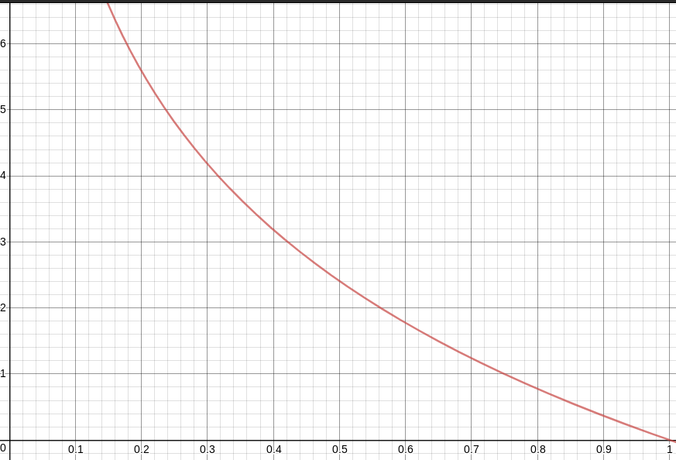
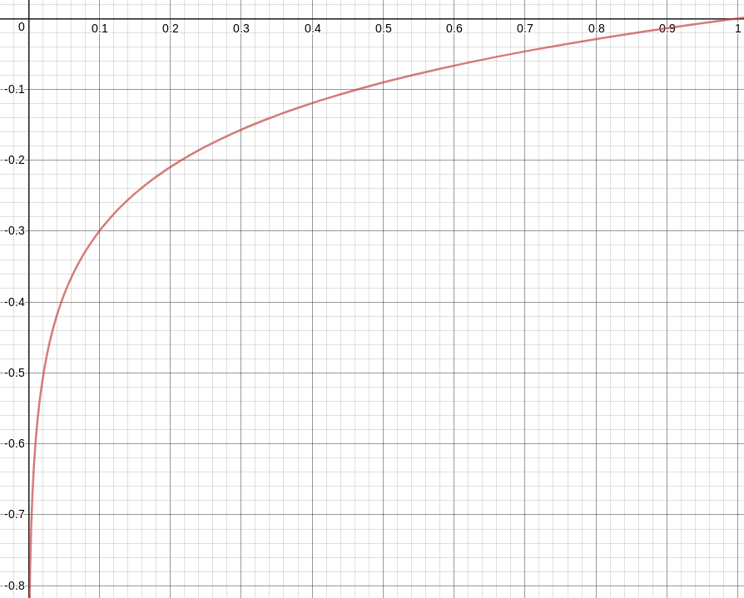
Backup - Policy Based Methods
Policy based functions update the probabilities with respect to the rewards obtained.
When rewards are positive, the slope of the function pushes the probability towards 1
When rewards are negative, the slope of the function pushes the probability towards 0

Slide 24
Backup - Value Based Methods
Notice the following useful property of the value function,
Using this, we can construct a way to update our value function.

Slide 25
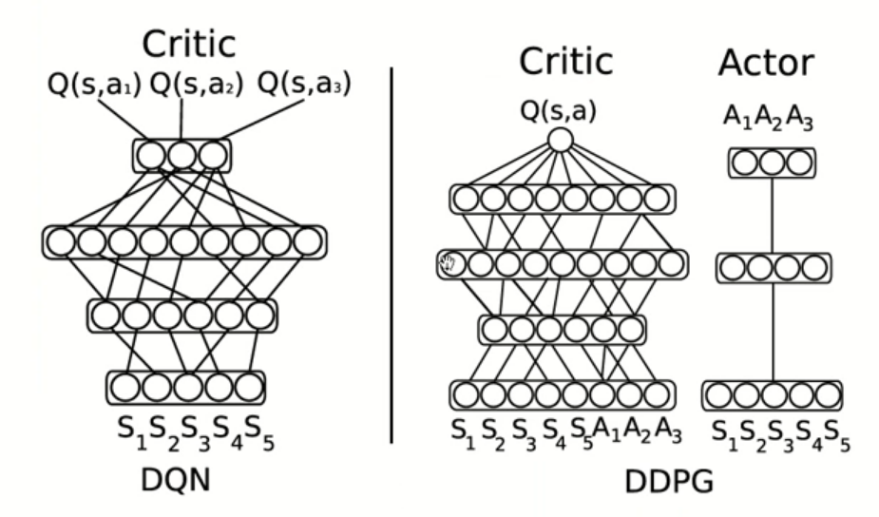
Backup - DDPG

Slide 26
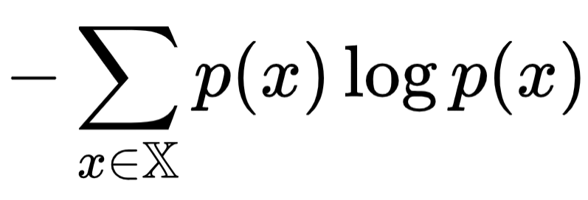
Backup - Exploration
Exploration in QEP occurs by maximizing Entropy.
It is defined as:
Graphic by Rudy Gilman

